Slide 1
Voice Emotion Analysis

Slide 2

Overarching Question
Can a machine recognize the emotions in a person’s voice?

Slide 3




Can a machine recognize the emotions in a person’s voice?
Why Does It Matter?
Voice recognition technology is used daily all over the world.
Digital assistants, automated phone systems, hands free phone pairing
Adding the emotional context of voices could greatly increase a computers understanding of what’s being said.

Slide 4




Can a machine recognize the emotions in a person’s voice?
How Can It Be Done?
Turn one-dimensional sound into a two-dimensional picture.
They say a pictures worth a thousand words! Extracting audio features as images can provide a much greater source of information.
Use these images to train a convolutional neutral network (CNN).
CNN Models are the go-to for analyzing images, best known for classifying handwriting and even cat pics.

Slide 5

Feature Selection

Slide 6
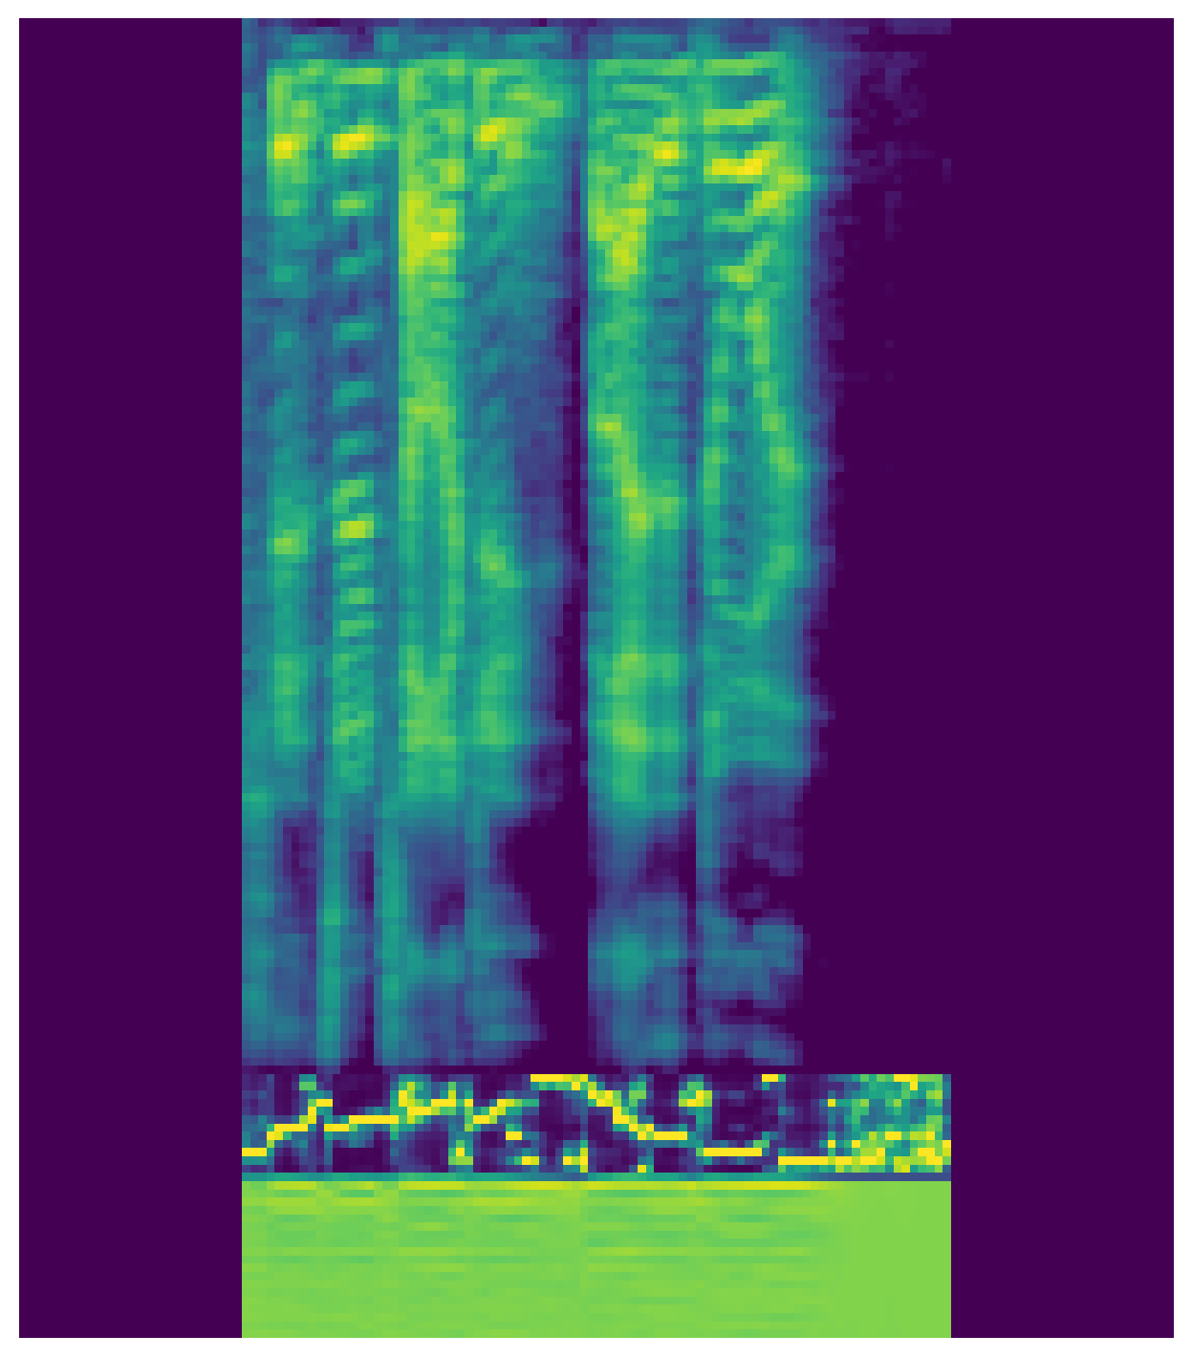
Feature Selection
Mel-Frequency Spectrogram
Each audio clip was broken up into three features.
These features were extracted as 2D arrays and stacked together to make a single image for each audio clip.
Chroma Features
Cepstral Coefficients

Slide 7
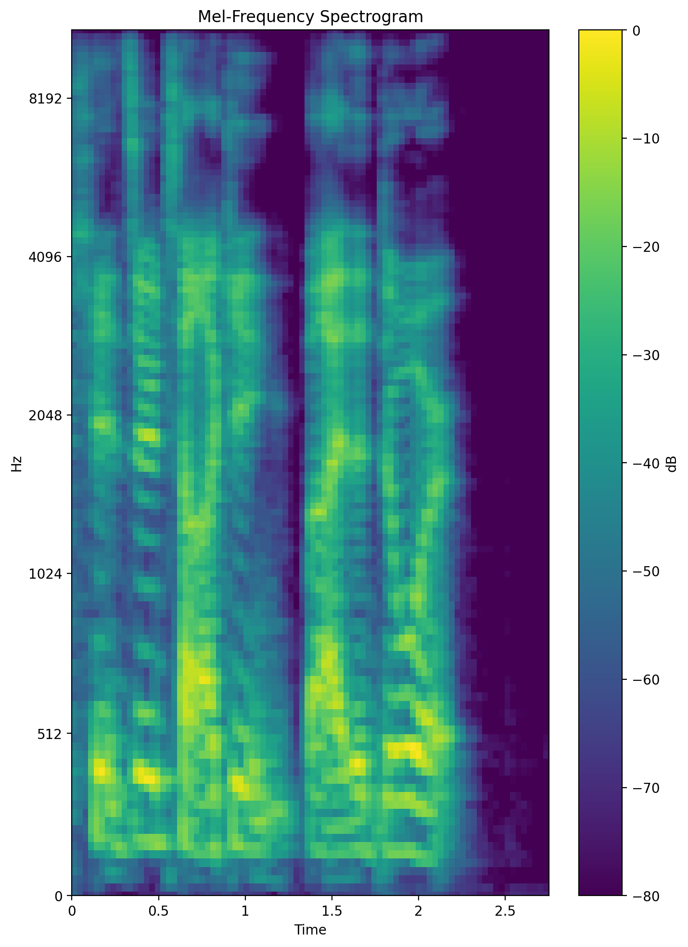
Mel-Frequency Spectrogram
A visualization of the frequency spectrum created using the mel scale.
Mel Scale: non-linear pitch scale based on human hearing
Shows how the energy of a signal changes with time, focusing particularly on the human perception of these characteristics.

Slide 8
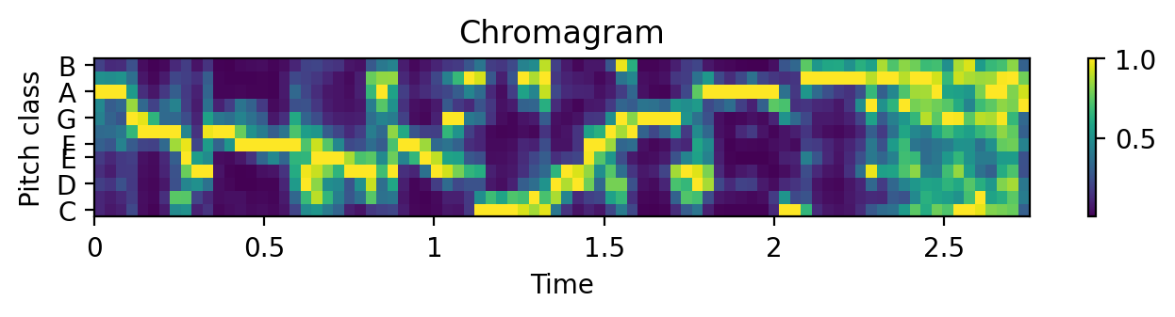
Chroma Features
A break down the energy of an audio signal into one of the twelve pitch classes.
Provides an overall profile of how the pitch of a sound shifts with time.

Slide 9
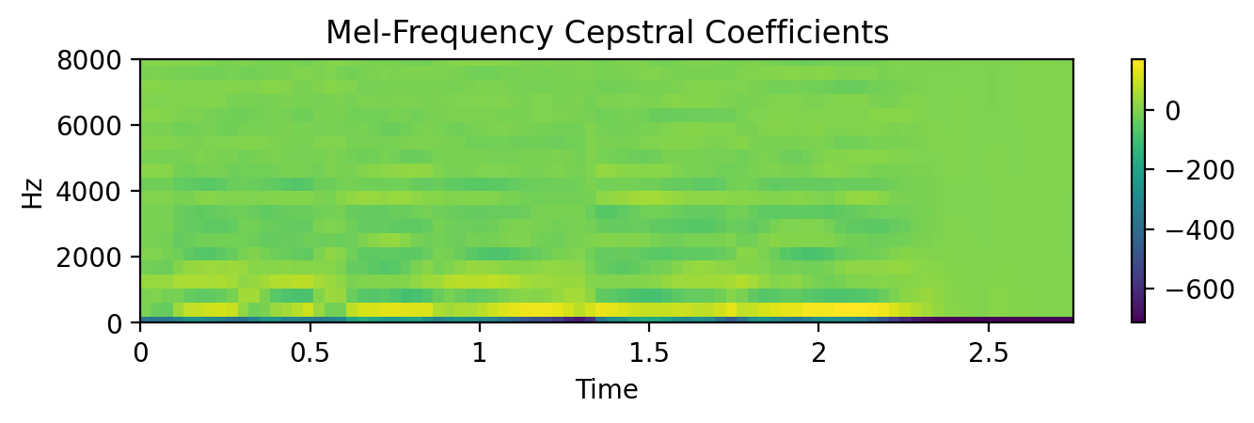
Cepstral Coefficients
Coefficients of the power spectrum of the audio.
Typically used to model and understand the qualities of human voices.

Slide 10

Model

Slide 11







Four Models
Two model architectures were tested, each using a different pooling layer between convolution layers.
MAX: max pooling layers
AVG: average pooling layers
Both were trained twice with using two sets of labels
EM: 6 emotion labels
SG: 12 emotion/gender labels

Slide 12
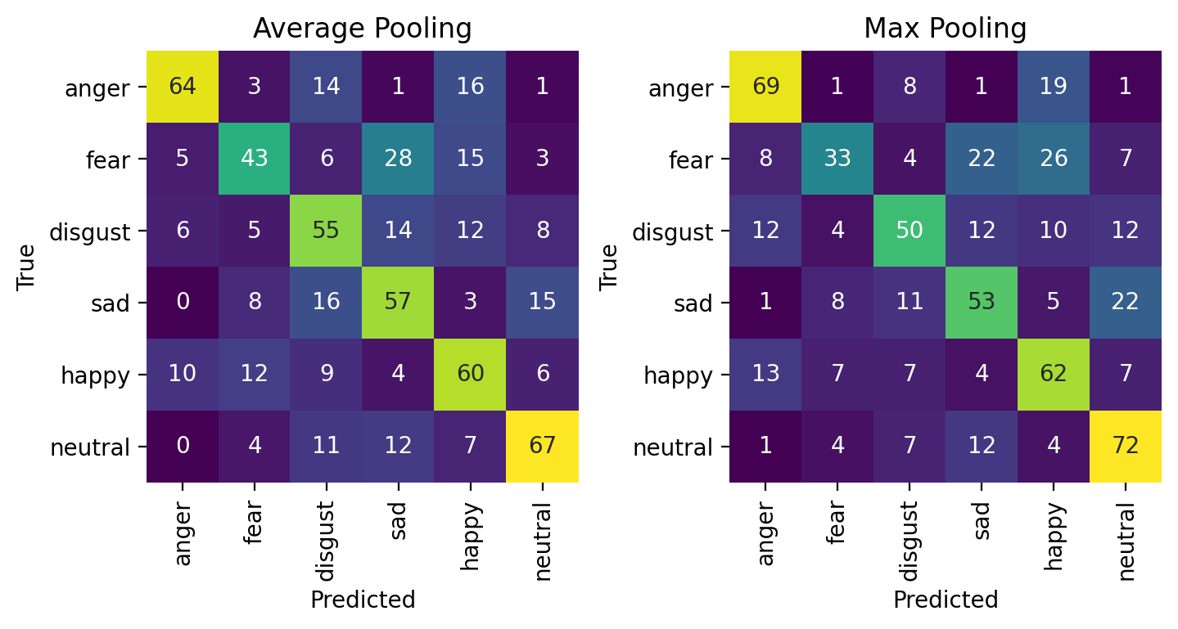
Model Results Emotion
Accuracy of models trained on emotion labels only:
AVG_EM: 57%
MAX_EM: 56%
* random chance: 17%

Slide 13

Model Results Emotion
Accuracy
of 49%
Accuracy
of 57%
AVG_EM had slightly better scores overall…
But MAX_EM was better at classifying disgust.

Slide 14
Model Results Emotion
43% of fear was misclassified as sad or happy
48%
For MAX_EM
Both had a tendency to over-label emotions as either sad or happy…
Particularly fear

Slide 15
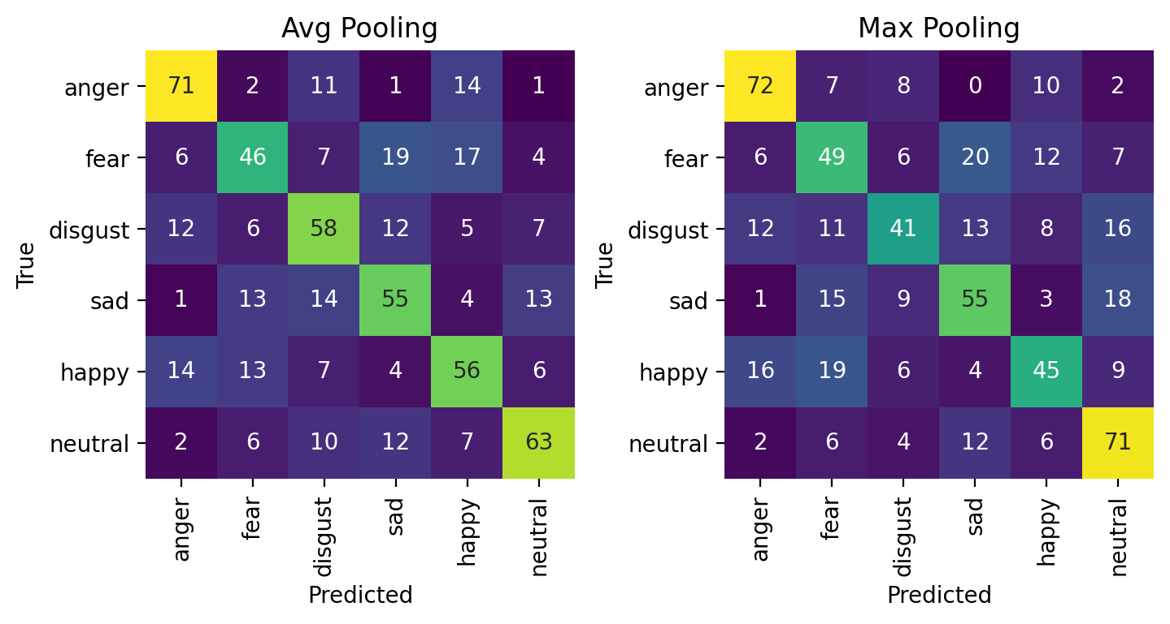
Model Results Emotion & Gender
Accuracy of models trained on emotion and gender:
AVG_SG: 58%
MAX_SG: 55%

Slide 16
Model Results Emotion & Gender
But MAX_SG had the better precision
Both had similar recall
AVG_SG was overall a much better model than MAX_SG…
Although MAX_SG was slightly better at determining anger.

Slide 17
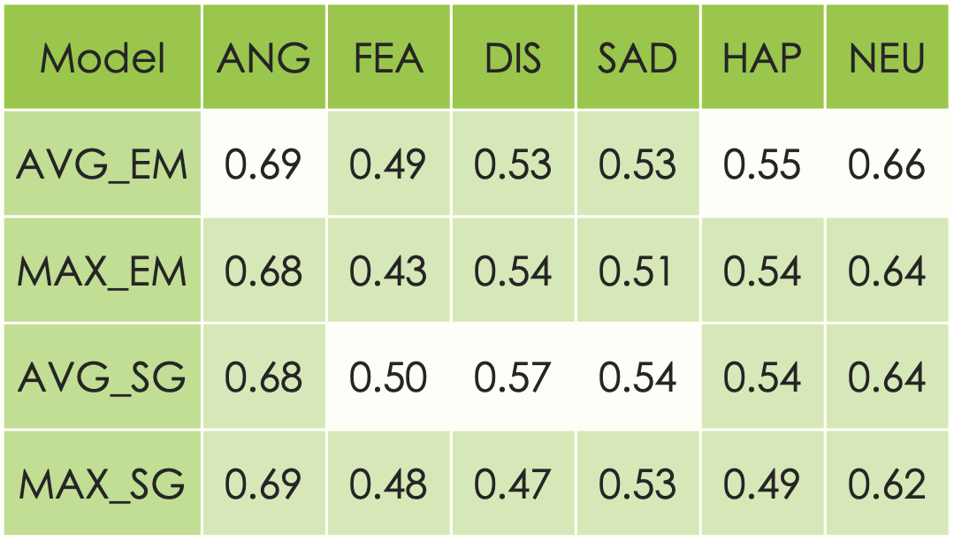
Model Results
AVG_SG was the best model overall.
In terms of the independent emotions though, the best scores were split between AVG_EM and AVG_SG.
So what if the two best models were combined?

Slide 18

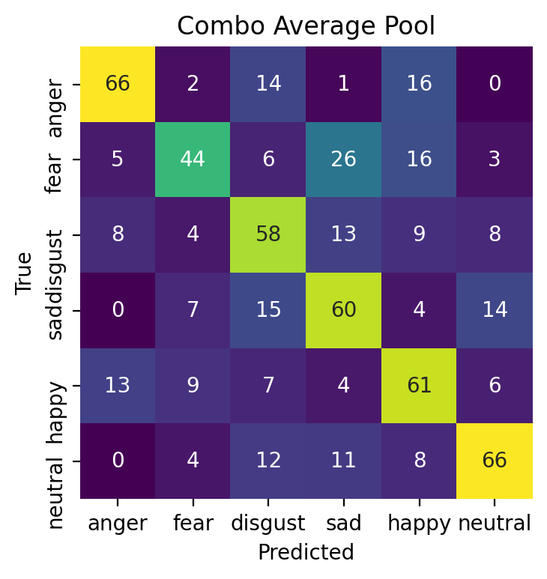
Combination Model
Accuracy of 59%
Scores highest of all the models for all emotions except for disgust.
F1 score beat by AVG_SG by only 0.01
Overall Best Model!

Slide 19




Final Model Testing
Movie Scenes!
* And a couple of my own recordings
The final combination model was trained on all the audio clips in the dataset.
With no more data to test on, how can we find out how well it preforms?

Slide 20
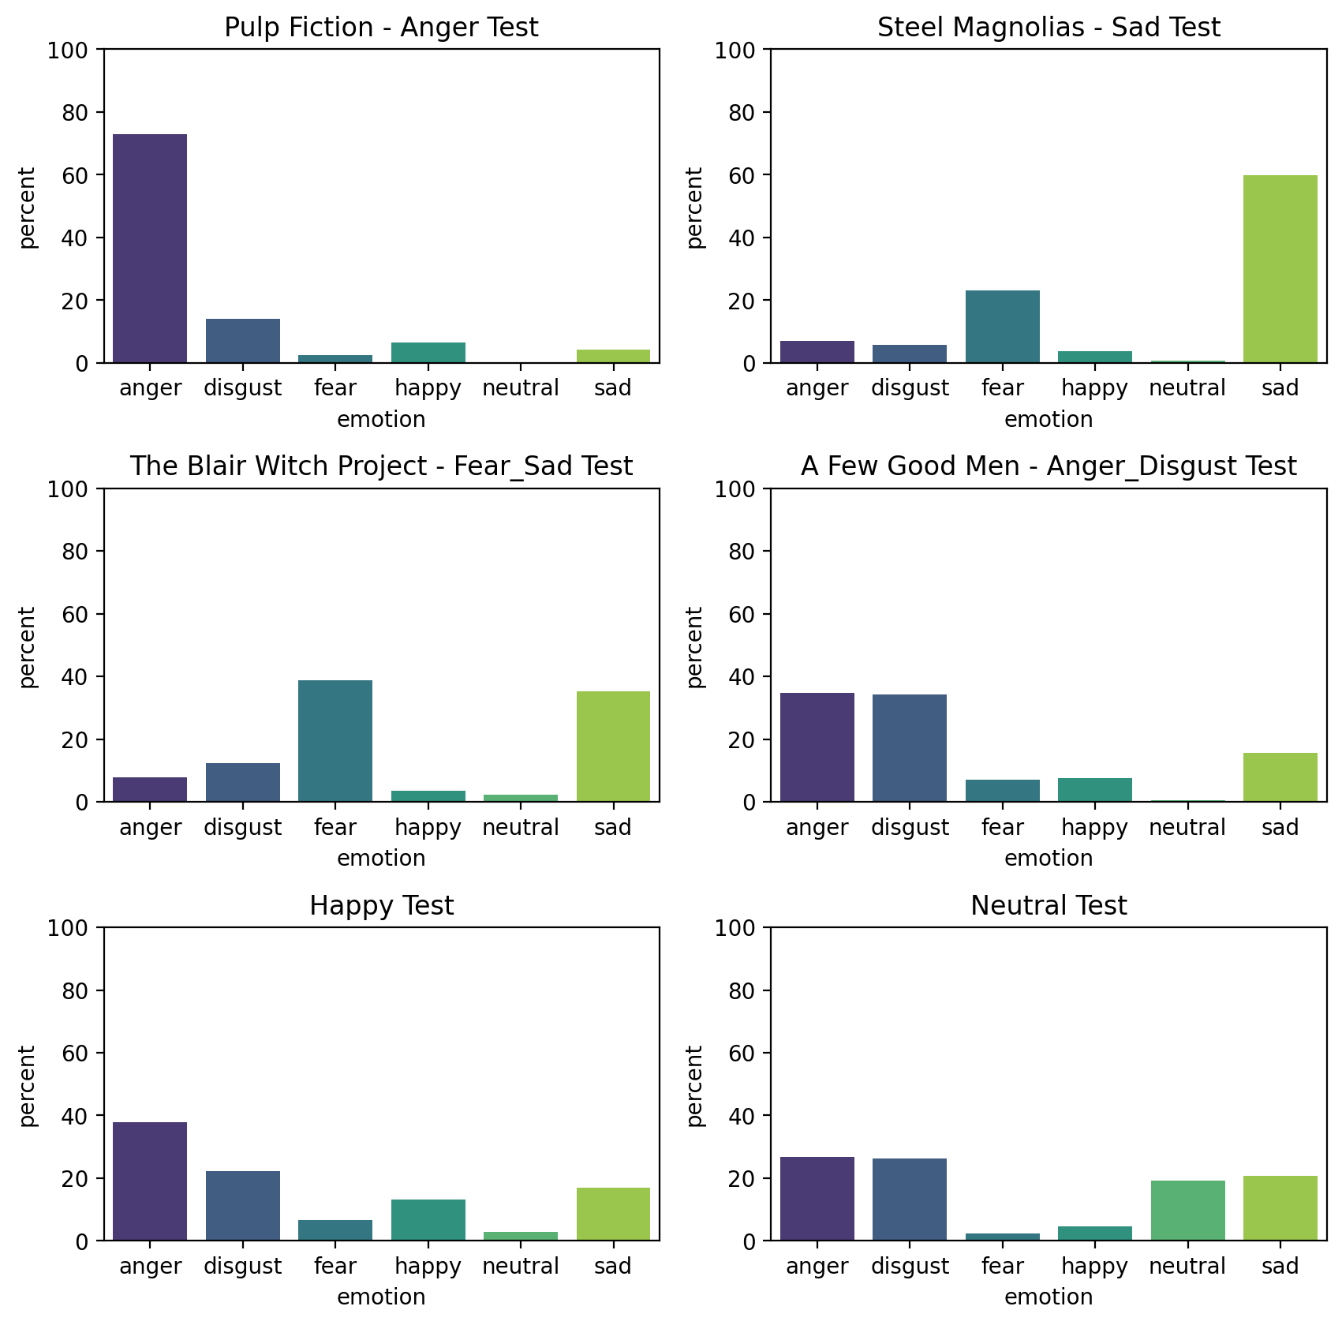


Final Model
Testing
Anger
Sad
Overall results:
The final model was good at classifying negative emotions
But struggled to classify the more positive emotions.
Mislabeling them as anger and disgust
Fear/Sad
Anger/Disgust
Anger
???

Slide 21

Conclusion

Slide 22


Summary
A combination of the average pooling models gave the best test results (59%)
The final model could identify the negative emotions anger, sad, disgust, and fear, but struggled with the more positive emotions happy and neutral.
This may be because these emotions tend to be less intensive
Neutral can be seen as an ‘absence’ of emotion rather than an emotion itself.

Slide 23
Moving Forwards
There’s always room for improvement! What else can be done?
More Data
A greater pool of audio clips to train on can help the model learn.
Higher Complexity
This model was made simple to save resources, a more complex model may provide higher accuracy.
Binary Classification
The model was good at identifying negative emotions, perhaps it would be easier if the model was trained to classify emotions simply as either positive or negative.

Slide 24
Can a machine recognize the emotions in a person’s voice?
Even with such limited data and resources, this simple model was able to identify emotions quite well.
While currently it has a limited accuracy, there are plenty of directions to pursue continued growth and improvement!
Yes!

